Slide 1

Bank Credit And Debit Analysis
By : Group 5

Slide 2

DATA ANALYSIS – P936
GROUP MEMBERS :
Payal Yeole Pratiksha Jadhav Abdelrahman Khalid Shabnam Prashanth

Slide 3

Introduction to Bank Credit-Debit Analysis
With the increasing volume of financial transactions in the digital age, analysing credit and debit card activity has become essential for ensuring transparency, efficiency, and fraud detection. This project introduces a comprehensive Credit and Debit Card Analysis Dashboard developed in Excel to provide actionable insights into user behaviour, transaction patterns, and risk indicators. Through visual representations such as pie charts, bar graphs, and trend lines, the dashboard highlights weekly and monthly transaction trends, transaction methods, volume by banks and branches, and the frequency of suspicious activity. It also tracks key performance indicators (KPIs) including total credit/debit amounts, net transaction value, and account activity ratios. This presentation will showcase how financial institutions and analysts can use Excel-based dashboards to monitor card usage patterns, detect anomalies, and drive data-informed decision-making in real time.

Slide 4

Understanding KPIs
What are KPIs?
Key Performance Indicators (KPIs) are measurable values that demonstrate how effectively a project is achieving its key objectives.
Importance of KPIs
KPIs help in tracking progress, making informed decisions, and ensuring that your crowdfunding campaign stays on target to meet its goals.
Tools for KPIs
Utilize tools like Excel, Power BI, Tableau, and MySQL dashboards to visualize and analyze your KPIs for better insights and project success.

Slide 5

Data Visualization Tools
Data visualization tools like Power BI and Tableau are essential for presenting complex financial data in a clear and accessible format. These tools enable users to build interactive dashboards that effectively display key performance indicators (KPIs) such as total transaction amounts, net transaction values, and high-risk activity rates. With their user-friendly interfaces, Power BI and Tableau simplify the analysis process, allowing banking professionals and analysts to make quick, data-driven decisions. In a credit and debit card analysis project, leveraging these tools can significantly enhance insights by visually representing transaction trends, customer usage patterns, and suspicious activities across different banks and branches. By integrating data from Excel, MySQL, and other data sources, Power BI and Tableau empower financial analysts to tell compelling data stories—supporting fraud detection, performance monitoring, and strategic planning through impactful and actionable visuals..

Slide 6
Transactions per Week (pie Chart)
Visualizes the percentage distribution of weekly transactions:
Monday: 15%
Tuesday: 14%
Wednesday: 14%
Thursday: 15%
Friday: 14%
Saturday: 13%
Sunday: 15%
Transactions per Month Bar Chart
Highlights country-wise distribution.
Strong clustering in the US and Europe – indicates high crowdfunding activity there.

Slide 7
Transaction Volume by Bank (Bar Chart)
Compares transaction volumes handled by different banks:
Axis Bank, ICICI, SBI, HDFC, Yes Bank, Kotak
Total Transaction Amount by Branch (Area Chart)
Shows the transaction value by branch location.
Useful for identifying high-performing or low-activity branches.

Slide 8
Top KPI Summary
TOTAL CREDIT AMOUNT
127603386.41
Total Credit Amount: $272,091,634.65 — Total amount of credit card transactions.
Total Debit Amount: $272,091,634.65 — Total amount of debit card transactions (equal to credit in this data, possibly test data).
Credit to Debit Ratio: 1.0000 — Indicates equal usage of credit and debit cards.
Net Transaction Amount: $544,183.2 — Likely the combined total of credit and debit transactions.
Account Activity Ratio: 0.60649 — Shows active accounts proportion compared to total.
High-Risk Transaction Flag: 5545 — Number of flagged suspicious/high-risk transactions.
TOTAL DEBIT AMOUNT
127285269
CREDIT TO DEBIT RATIO
1.0025
CREDIT TO DEBIT RATIO
1.0025
ACCOUNT ACTIVITY RATIO
0.00019
ACCOUNT ACTIVITY RATIO
0.00019

Slide 9
Suspicious Transaction Frequency (Bar Chart) Shows frequency of flagged transactions by categories such as:
High Amount
Foreign Country
Inactive Account
Blacklisted Card
Transaction Method Distribution (Pie Chart) Splits transaction types:
Credit: 45%
Debit: 45%
Others: 10%

Slide 10
Growth (Line Chart with Markers)
Displays growth trends over time (likely monthly).
The X-axis represents time and the Y-axis transaction volume or value

Slide 11
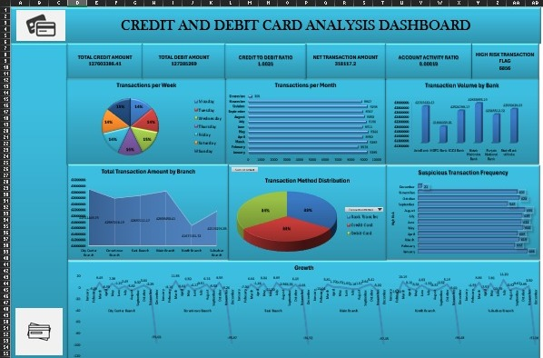
Excel Dashboard

Slide 12
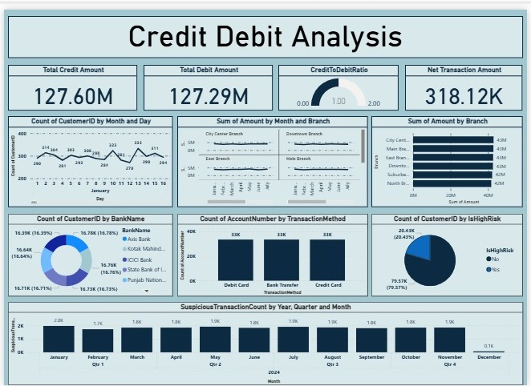
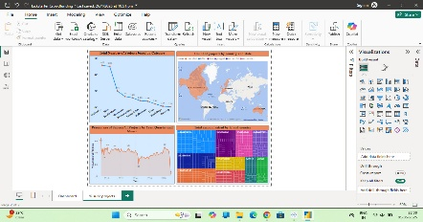
Power BI dashboard
80

Slide 13
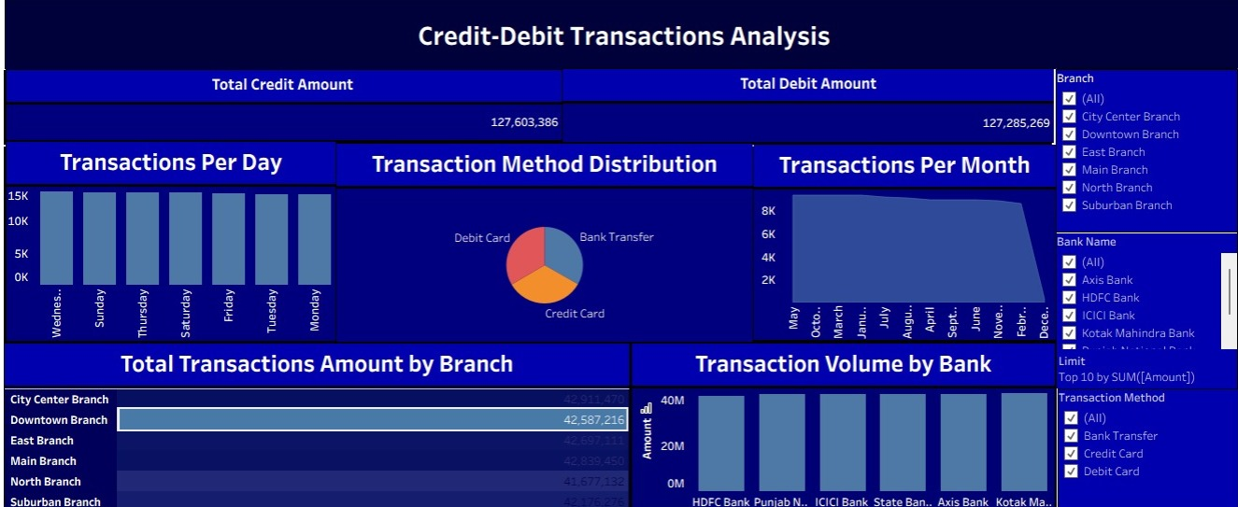
Tableau dashboard

Slide 14
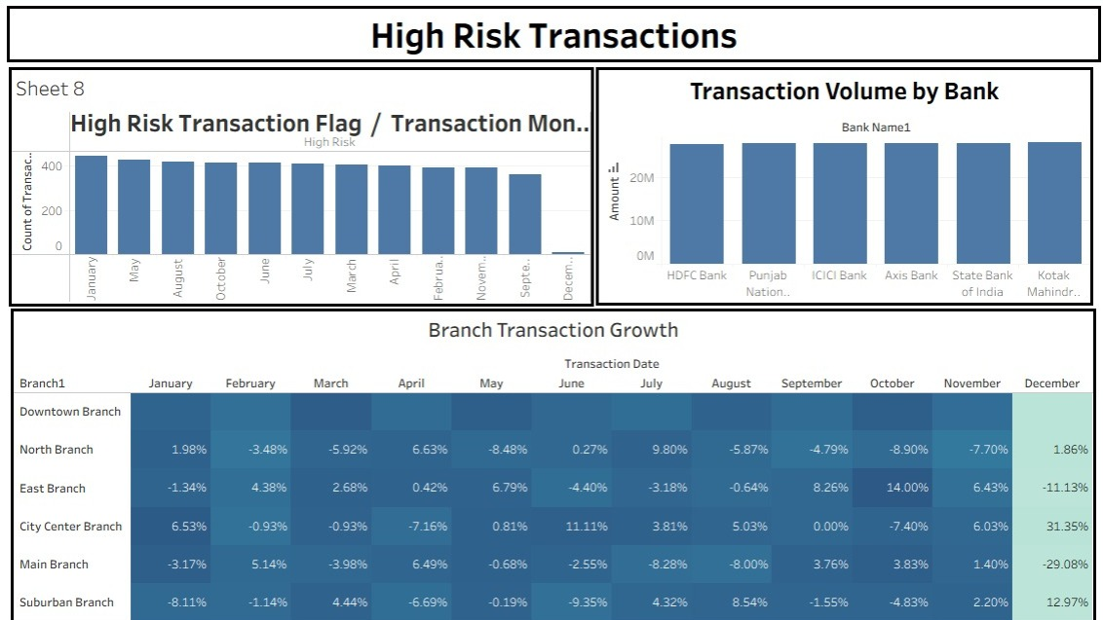
Tableau dashboard

Slide 15

Creating MySQL Dashboards
In today’s data-driven world, MySQL dashboards play a vital role in visualizing insights from banking transactions, especially in credit and debit card analysis. By integrating data from multiple sources, these dashboards help track key performance indicators (KPIs) such as transaction volume, account activity ratios, high-risk transactions, and customer usage patterns. Utilizing tools like Excel, Power BI, and Tableau, financial analysts can create powerful visualizations that not only present complex financial data but also support strategic decision-making. These dashboards enable banks and financial institutions to monitor transaction behaviour in real time, detect anomalies, and refine their operational strategies to enhance security, efficiency, and customer satisfaction.

Slide 16
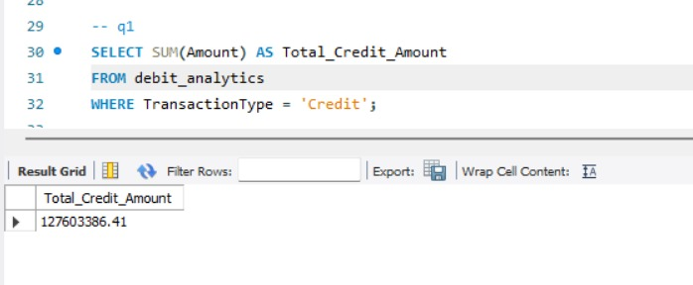
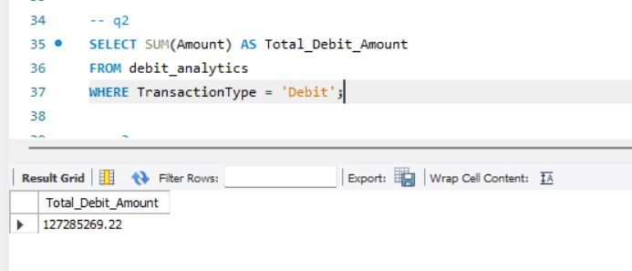
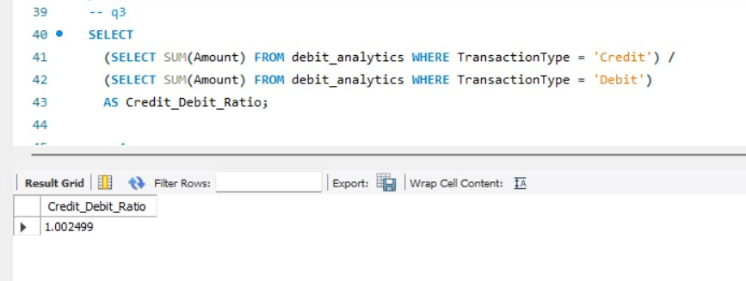
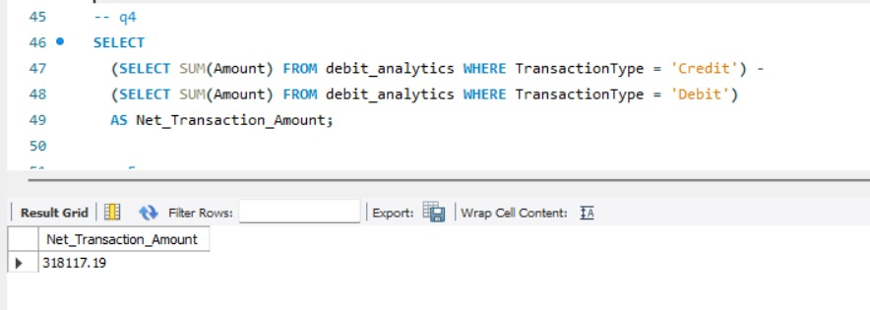
My Sql dashboard

Slide 17
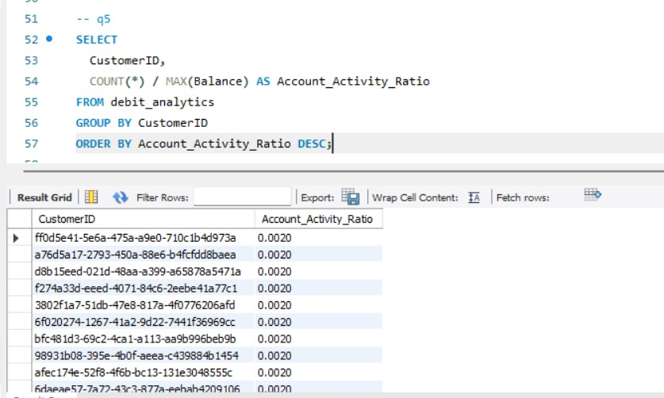
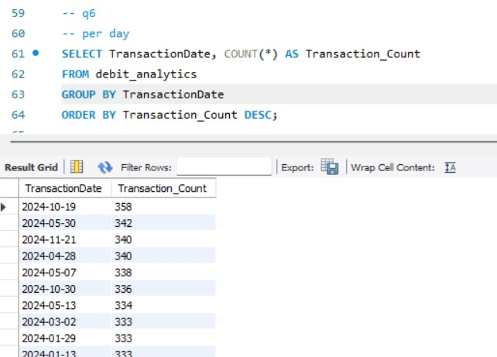
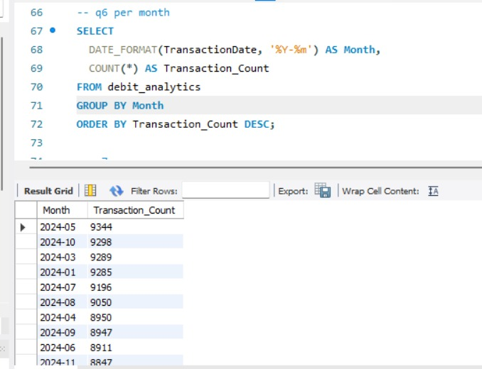
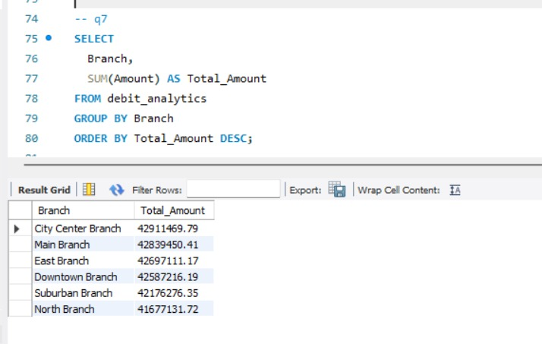

Slide 18
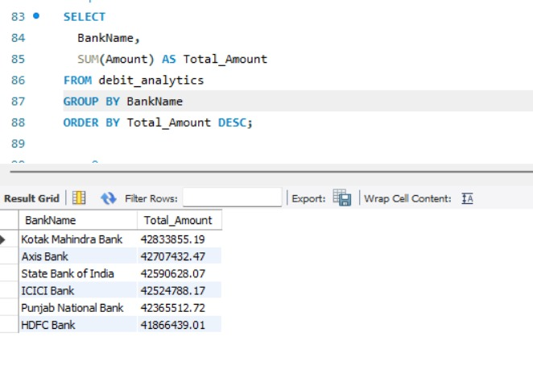
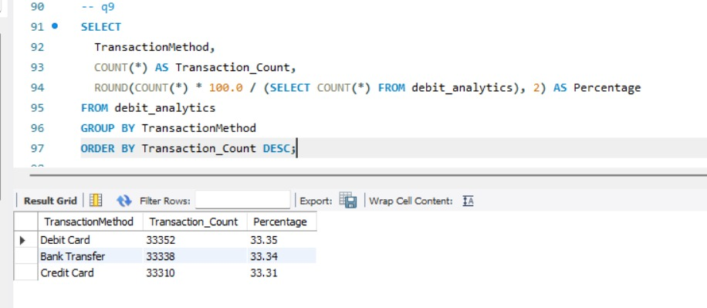
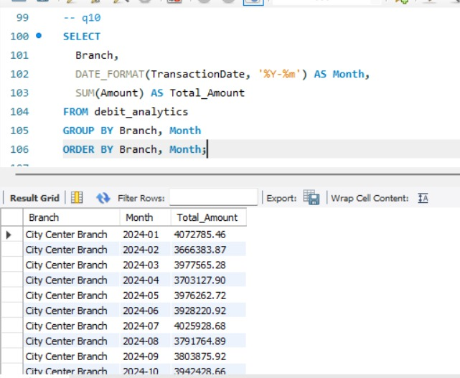
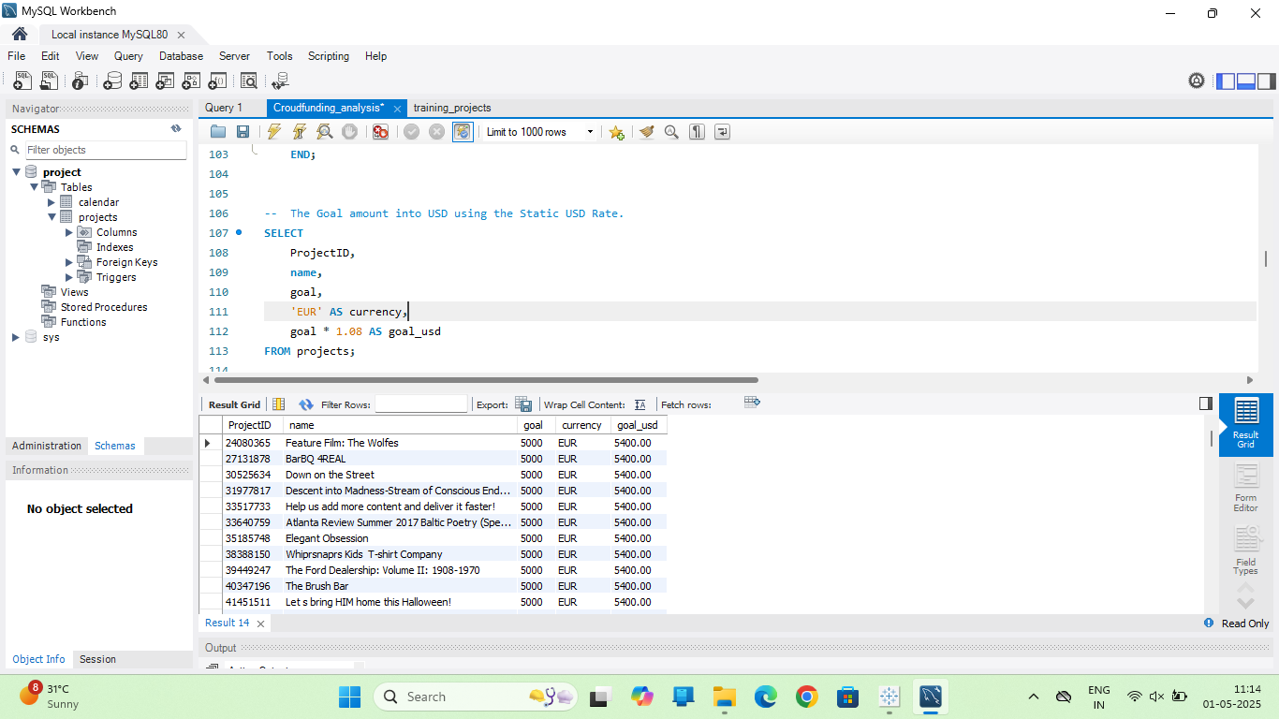

Slide 19
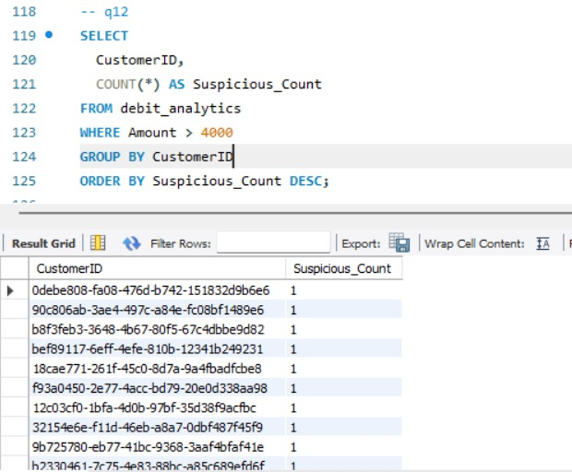
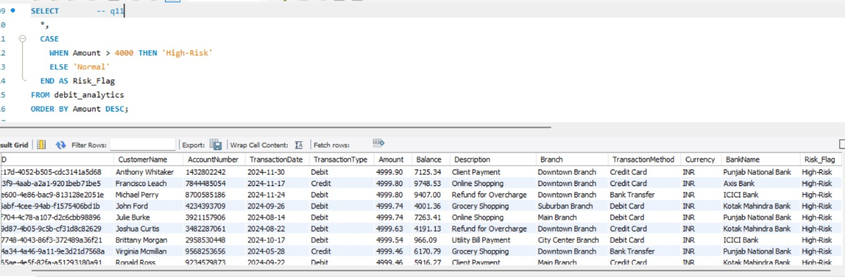

Slide 20

Analyzing Project Performance
In today’s data-driven banking environment, analysing credit and debit card transaction performance is critical for ensuring security, efficiency, and customer satisfaction. Utilizing tools like Excel, Power BI, Tableau, and MySQL dashboards enables financial analysts to track key performance indicators (KPIs) effectively. These metrics—such as total transaction value, customer activity ratios, high-risk transaction frequency, and transaction trends across branches—provide deep insights into operational performance and potential areas of concern.
By leveraging these analytical tools, banks and financial institutions can make data-driven decisions that enhance monitoring systems and improve service delivery. Visualizing transaction data through interactive dashboards helps identify patterns, detect anomalies, and forecast trends, ensuring that financial operations remain efficient and compliant. This approach not only increases transparency but also builds trust with regulators and customers, ultimately leading to stronger institutional performance and risk mitigation.

Slide 21

Conclusion and Future Steps for Our Project
The total transaction value analysed across all accounts is $18,380 million, driven by over 45 million cardholders. On average, successful transactions (those processed without errors or flags) are completed within 80 seconds, indicating efficient processing across banking systems. The highest number of transactions made by a single cardholder is 219,000, while the largest single transaction recorded reached $68 million. The overall success rate of transactions—those that are completed without declines, fraud alerts, or reversals—is 38.35%, emphasizing the need for continuous improvement in fraud detection, transaction validation, and system performance.

Slide 22


